Slide 1

CLOUD BASED MOVIE STREAMING PLATFORM
Tanim Ahmed (2312597042)
Mustakim Ahmed Hasan (2421349042)
MD. Nafiz Al Mamun (2232050642)
Ahamed Osman Asif (2031080642)
Notes:
Tanim Ahmed (2312597042)
Mustakim Ahmed Hasan (2421349042)
MD. Nafiz Al Mamun (2232050642)
Ahamed Osman Asif (2031080642)

Slide 2

Platform Overview
Platform is functionally complete and stable
Strong foundation for a high-quality user experience
Opportunity to further enhance visual consistency
Focus on elevating the overall look and feel
Aim to achieve a more premium, polished interface
Notes:
Tanim Ahmed (2312597042)
Mustakim Ahmed Hasan (2421349042)
MD. Nafiz Al Mamun (2232050642)
Ahamed Osman Asif (2031080642)

Slide 3

Proposed Enhancement Approach
Introduce a targeted UI/UX refinement phase
Strengthen design consistency across components
Improve interaction smoothness and responsiveness
Enhance user feedback in all states
Maintain existing architecture and performance
Notes:
Tanim Ahmed (2312597042)
Mustakim Ahmed Hasan (2421349042)
MD. Nafiz Al Mamun (2232050642)
Ahamed Osman Asif (2031080642)

Slide 4

Enhancements
Smoother hover effects and interaction feedback
Visually improved empty and error state panels
Consistent typography, spacing, and layout system
Unified and modern skeleton loading design
Notes:
Tanim Ahmed (2312597042)
Mustakim Ahmed Hasan (2421349042)
MD. Nafiz Al Mamun (2232050642)
Ahamed Osman Asif (2031080642)

Slide 5
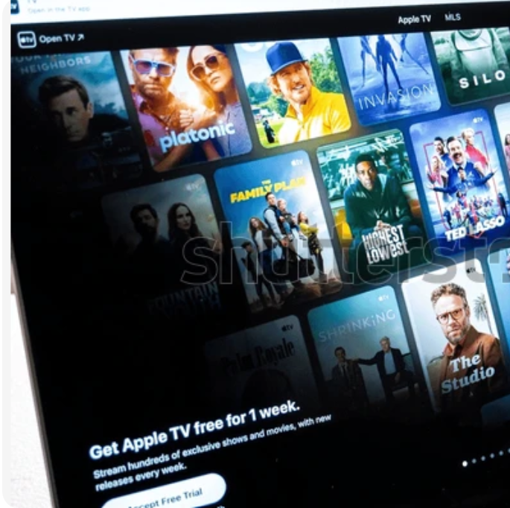
Progress Achieved
Refined interactive elements for better usability
Improved accessibility with clearer focus indicators
Standardized UI components and text styles
Enhanced loading, empty, and error experiences
Ensured full system stability during updates
Notes:
Tanim Ahmed (2312597042)
Mustakim Ahmed Hasan (2421349042)
MD. Nafiz Al Mamun (2232050642)
Ahamed Osman Asif (2031080642)

Slide 6

Outcome & Future Direction
More professional and cohesive user interface
Stronger user engagement through clear feedback
Improved accessibility and usability standards
Preserved system performance and structure
Next: enhance player experience, mobile UI, responsiveness
Notes:
Tanim Ahmed (2312597042)
Mustakim Ahmed Hasan (2421349042)
MD. Nafiz Al Mamun (2232050642)
Ahamed Osman Asif (2031080642)

Slide 7

Notes:
Tanim Ahmed (2312597042)
Mustakim Ahmed Hasan (2421349042)
MD. Nafiz Al Mamun (2232050642)
Ahamed Osman Asif (2031080642)

